Slide 1
File Handling

Slide 2
Objectives
Read from text files
Write to text files
Read and write more complex data with files

Slide 3
Reading from Text Files
Plain text file: File made up of only ASCII characters
Easy to read strings from plain text files
Text files good choice for simple information
Easy to edit
Cross-platform
Human readable!

Slide 4
Reading & Writing Files - Overview
Opening and closing files
the_file = open(filename, mode)
the_file.close()
Reading files
string = the_file.read(number_of_characters)
string = the_file.readline(number_of_characters)
list_of_strings = the_file.readlines()
Writing files
the_file.write(string)
the_file.writelines(list_of_strings)

Slide 5
The Read It Program
File read_it.txt contains
Line 1
This is line 2
That makes this line 3

Slide 6
Opening and Closing a Text File
text_file = open("read_it.txt", "r")
Must open before read (or write)
open() function
Must pass string filename as first argument, can include path info
Pass access mode as second argument
Returns file object
"r" opens file for reading
Can open a file for reading, writing, or both

Slide 7
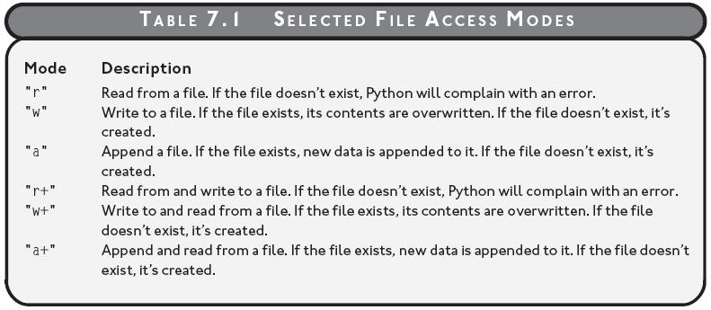
Opening and Closing a Text File (continued)
Table 7.1: Selected File Access Modes
Files can be opened for reading, writing, or both.

Slide 8
Opening and Closing a Text File (continued)
text_file.close()
close() file object method closes file
Always close file when done reading or writing
Closed file can't be read from or written to until opened again

Slide 9
Reading Characters from a Text File
>>> print text_file.read(1)
L
>>> print text_file.read(5)
ine 1
read() file object method
Allows reading a specified number of characters
Accepts number of characters to be read
Returns string
Each read() begins where the last ended
At end of file, read() returns empty string

Slide 10
Reading Characters from a Text File (continued)
>>> whole_thing = text_file.read()
>>> print whole_thing
Line 1
This is line 2
That makes this line 3
read() returns entire text file as a single string if no argument passed

Slide 11
Reading Characters from a Line
>>> text_file = open("read_it.txt", "r")
>>> print text_file.readline(1)
L
>>> print text_file.readline(5)
ine 1
readline() file object method
Reads from current line
Accepts number characters to read from current line
Returns characters as a string

Slide 12
Reading Characters from a Line (continued)
>>> text_file = open("read_it.txt", "r")
>>> print text_file.readline()
Line 1
>>> print text_file.readline()
This is line 2
>>> print text_file.readline()
That makes this line 3
readline() file object method
Returns the entire line if no value passed
Once you read all of the characters of a line (including the newline), the next line becomes current line

Slide 13
Reading All Lines into a List
>>> text_file = open("read_it.txt", "r")
>>> lines = text_file.readlines()
>>> print lines
['Line 1\n', 'This is line 2\n', 'That makes this line 3\n']
readlines() file object method
Reads text file into a list
Returns list of strings
Each line of file becomes a string element in list

Slide 14
Looping through a Text File
>>> text_file = open("read_it.txt", "r")
>>> for line in text_file:
print line
Line 1
This is line 2
That makes this line 3
Can iterate over open text file, one line at a time
Technique available beginning in Python 2.2

Slide 15
Writing to a Text File
Easy to write to text files
Two basic ways to write

Slide 16
Writing Strings to a Text File
text_file = open("write_it.txt", "w")
text_file.write("Line 1\n")
text_file.write("This is line 2\n")
text_file.write("That makes this line 3\n")
write() file object method writes new characters to file open for writing

Slide 17
Writing a List of Strings to a Text File
text_file = open("write_it.txt", "w")
lines = ["Line 1\n", "This is line 2\n", "That makes this line 3\n"]
text_file.writelines(lines)
writelines() file object method
Works with a list of strings
Writes list of strings to a file

Slide 18
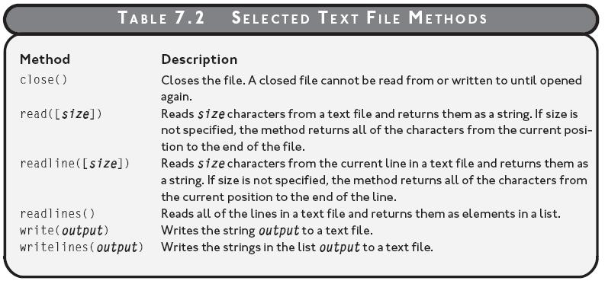
Selected Text File Methods
Table 7.2: Selected text file methods

Slide 19
Python Math
Built In Functions: min(), max(), abs(), pow()
Built in Module: math module
import math
u = math.sqrt(64) # returns square root
v = math.ceil(1.4) # returns 2 w = math.floor(1.4) # returns 1
x = math.pi #returns the value of Pi
#and many more…..

Slide 20
Dates
Import the datetime module and display the current date:
import datetime x = datetime.datetime.now() print(x)

Slide 21
Creating Date Objects
To create a date, use the datetime() class (constructor) of the datetime module. The datetime() class requires three parameters to create a date: year, month, day.
import datetime
x = datetime.datetime(2020, 5, 17)
print(x)

